Slide 1
Note Taking
How to Get the Most out of Lecture

Slide 2
What’s the Point?
Attendance and listening are important, but not enough.
You need to retain material.
For future reference.
To derive meaning from assigned readings.
To better understand what the professor believes to be important course material.
You not only want to pass the course, but use the information as a foundation for future courses.

Slide 3
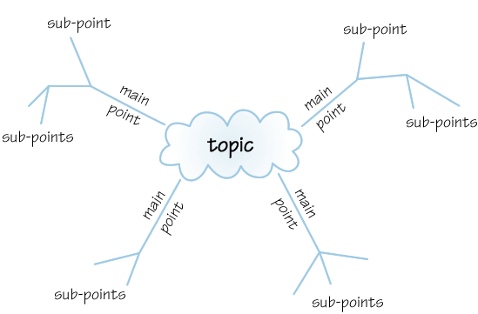
What makes for good notes?
Summarize main points.
Include prevalent ideas, written in your own words.
Contain specific details like dates, locations, people, theories, and definitions.
Legibly written.
Organized so that they are understandable for later study.
Contain information to help to put the text in context.
Sometimes include diagrams (example: “Mind Map” to the left).
Sometimes include illustrations and graphs.

Slide 4
So how do you get started?
The next slides will outline some strategies to get the most out of your note taking.

Slide 5
Be Prepared to Take Notes
Get to class early, so you are settled and ready when the lecture starts.
Sit where you can hear the speaker and see the board.
Know what topics will be covered ahead of time…read all assignments on syllabus.
Review notes from previous class session.
Bring correct note book! And writing utensil!
Or use your laptop to take notes.
Turn off cell phone!

Slide 6
Know Your Instructor’s Style
Does your instructor…
Lecture on text page by page?
Use lecture as a base but add
information from other sources?
Only lecture from other sources?
Speak quietly?
Ramble or go on tangents?
Use WebCT?
Listen to the way your instructor sets up the lecture, often it will be the similar style each lecture.
What can you do to adapt to your instructor’s style?
Sit up front?
Use a recorder?
Bring your text?
Visit their office hours with your notes?

Slide 7
Understand What You Write!
Be simple.
Be legible.
Capture main points.
Only contain details that are necessary for your purpose.
Be written in your own words.
Include any text reference your
professor gives (ex: More information on Pg. 239)
Review your notes DAILY!
Use your textbook as a guide for keeping your notes in order.
How do your notes compare?

Slide 8
Use the Same Method?
Many students find that sticking to a “routine” is what works best.
Use standard 8 ½ x 11 lined notebook paper?
Take notes on your laptop?
Use a traditional outline format?
Keep separate notebooks for each class?
Devise and use your own shorthand?
Different approaches for different classes? You bet.
Think about other methods that might work better for you…
Recorder?
Weekly rewriting?

Slide 9
What not to do:
Write so sloppy you can’t read your notes later.
Refuse to change your approach if your grades are not up to expectations.
Write notes in paragraph form, with little order.
Completely fill up all open paper space with notes.
Get frustrated if the process doesn’t come easy to you. Give it time and keep trying.
Use abbreviations that you will not understand later.
Not ask for assistance when you need it. Professors hold office hours so that you can access them with your questions.

Slide 10
This PowerPoint presentation is the
property of Northern Michigan University’s
Academic & Career Advisement Center. It
may not be reproduced without written
consent.
www.nmu.edu/acac

