Slide 1
Student Success Initiatives
Updates - Aug. 2021

Slide 2
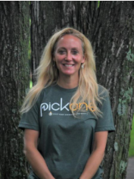
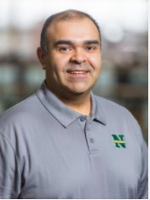
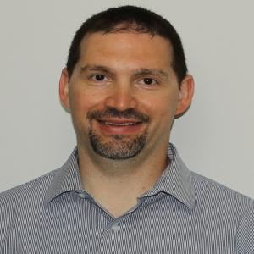
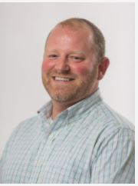
Jason Nicholas
Ast. Provost and Director
Institutional Research, Planning and Assessment
janichol@nmu
Rachel Harris
Director
Center for Student Enrichment
raharris@nmu
Jose Garcia
Coordinator - Acad. Support Services
ACAC
jogarcia@nmu.edu
Neil Baumgartner
Director - Student Success/Wellness
Dean of Students
nbaumgar@nmu.edu
Bill Richards
Senior Project Manager
IT/Finance
wirichar@nmu

Slide 3
Overview
Recent Student Success Initiatives
Major components
Pick One, Points, and The HUB
Embedded Success Specialists
Educational Success Platform (ESP)
HelioCampus & Data Science
Student Success Collaborative

Slide 5
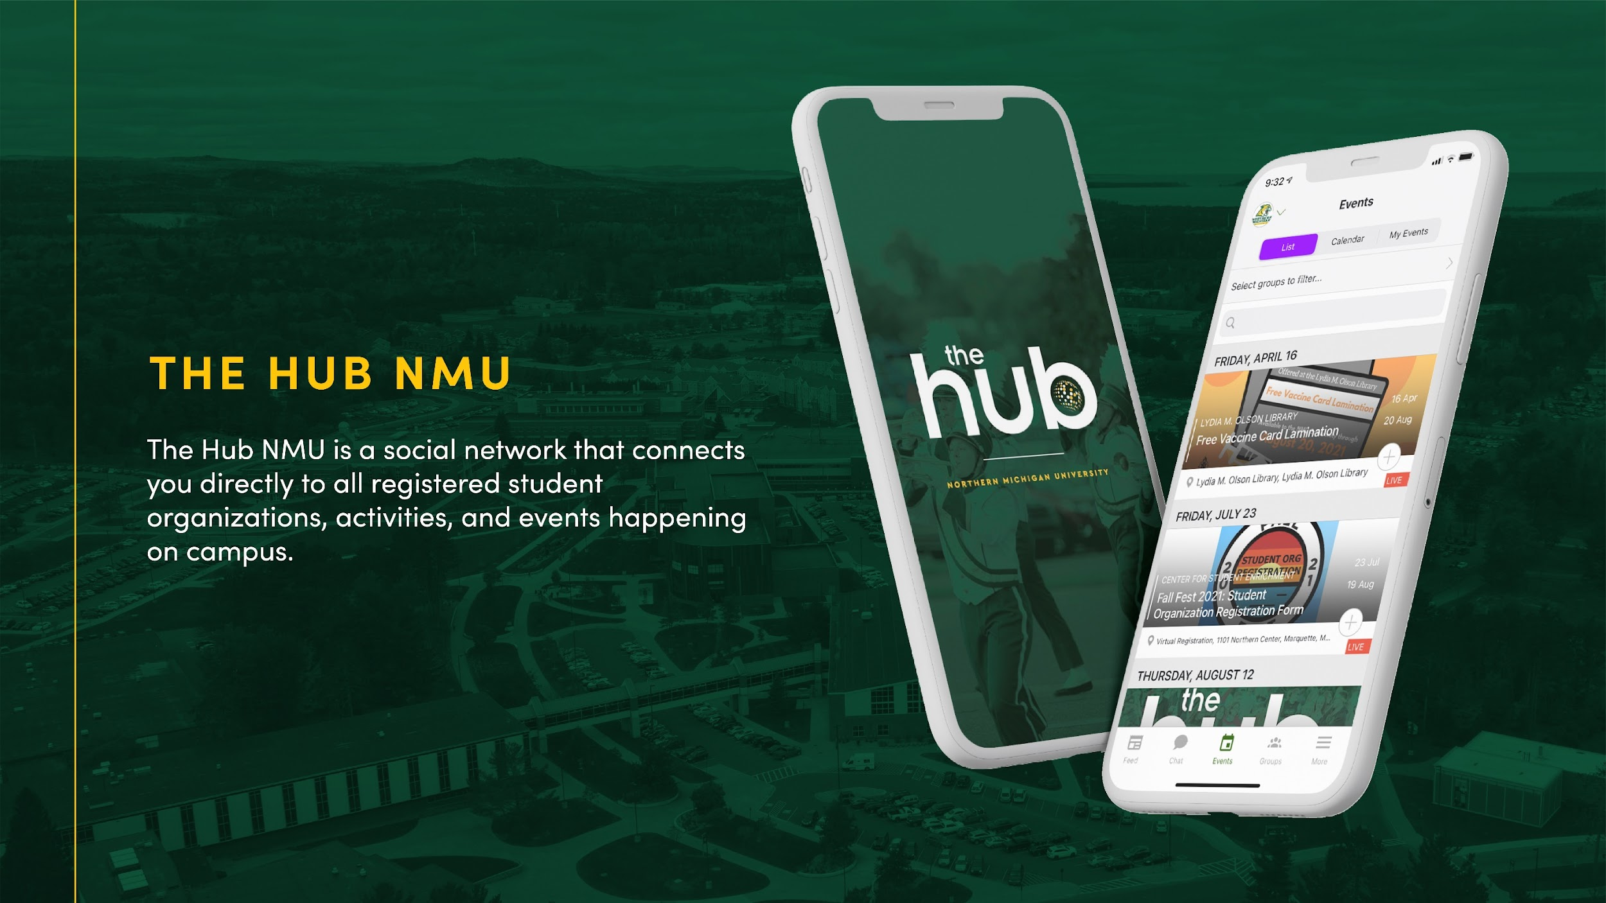

Slide 7
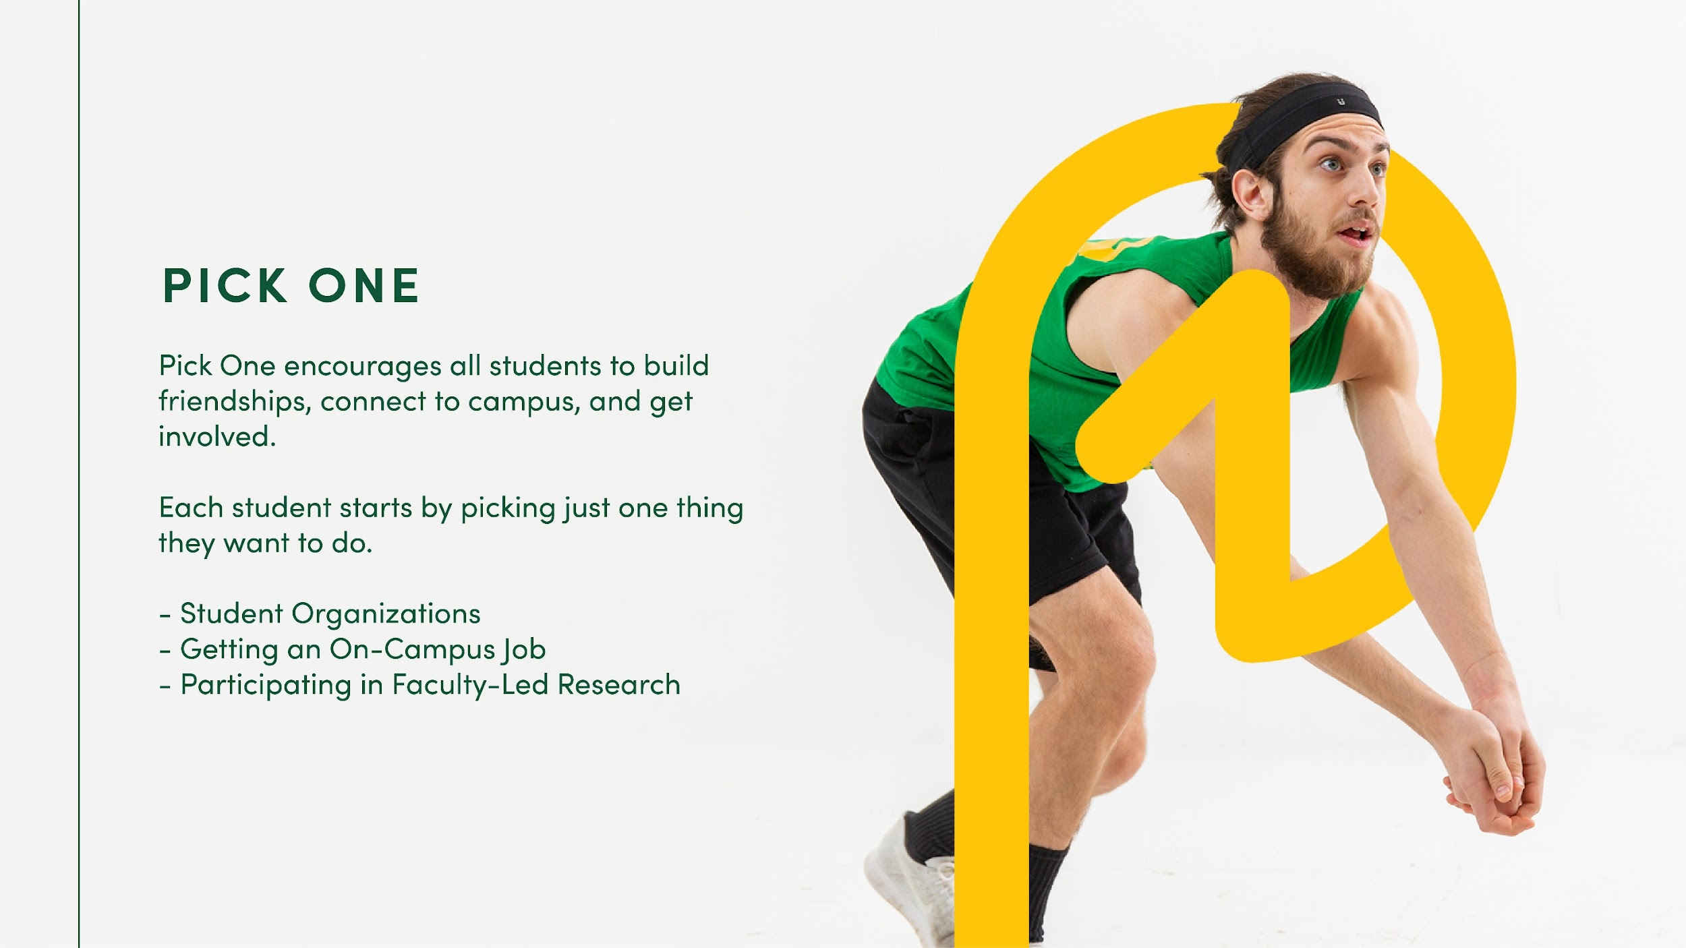

Slide 11
Embedded Success Specialists
Who are they, and what do they do?
How does this model support and impact faculty and students?
How is this transition taking place?

Slide 12
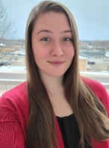
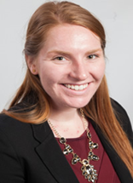
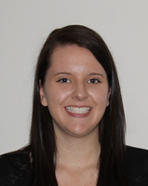
Embedded Success Specialists
Lauren Anargyros
Biology
Kelsey Avey
Earth, Environmental, & Geographical Sciences
Math & Computer Science
Physics
Brittanie Barry
Communication and Media Studies
Economics
English
History
Philosophy
Political Science

Slide 13
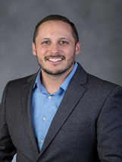
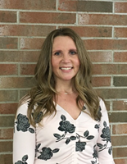
Embedded Success Specialists
Anna Irish Burnett
Engineering Technology
Technical and Occupational Sciences
Nick Garcia
Chemistry
Kristen King
School of Health and Human Performance
School of Clinical Sciences

Slide 14
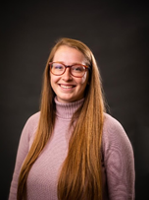
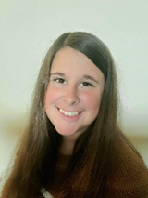
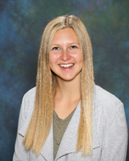
Embedded Success Specialists
Miranda McShane
College of Business
Tara Schafer
School of Nursing
Social Work
Breann Tjaarda
Criminal Justice
Psychology
Sociology & Anthropology

Slide 15
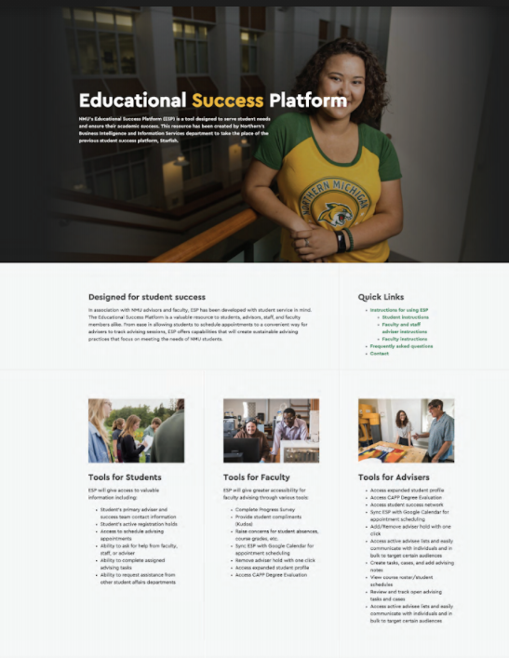
What is ESP?
ESP = Educational Success Platform.
ESP provides a portal for NMU students, advisers, and faculty to manage academic advising activities and related information.
ESP is the replacement for Starfish. Developed with input from advisers, students, and faculty.
www.nmu.edu/acac/esp

Slide 16
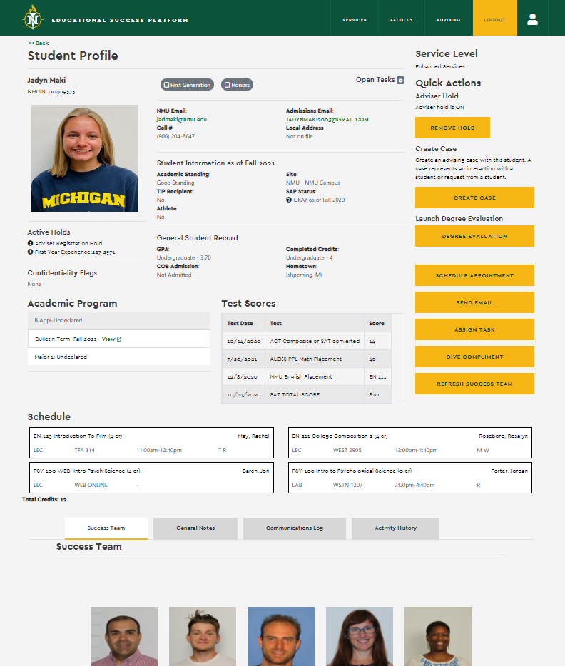
Features:
Appointment scheduling
Student profile view
Holds - view and remove
Success team - view and communicate
CAPP degree evaluation access
Automated notifications
Flags and alerts - now cases and tasks
Progress Surveys - mid-term grades
Sortable lists
Bulk actions for efficiency

Slide 17
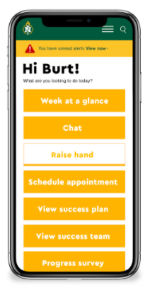
Benefits:
ESP works on all mobile devices
Expanded student profile - more information
A “leaner” interface - fewer clicks
Real-time integration with Banner - (no more delay)
No more 25 students per screen limit!
Communications - email AND TEXT
NMU branding, and maintains the NMU website look and feel
“Localized” control over functions, design AND data security
More data sources - think Helio analytics, CampusGroups, etc.
Extensible - add features as additional needs are identified

Slide 18
HelioCampus & Data Science

Slide 19
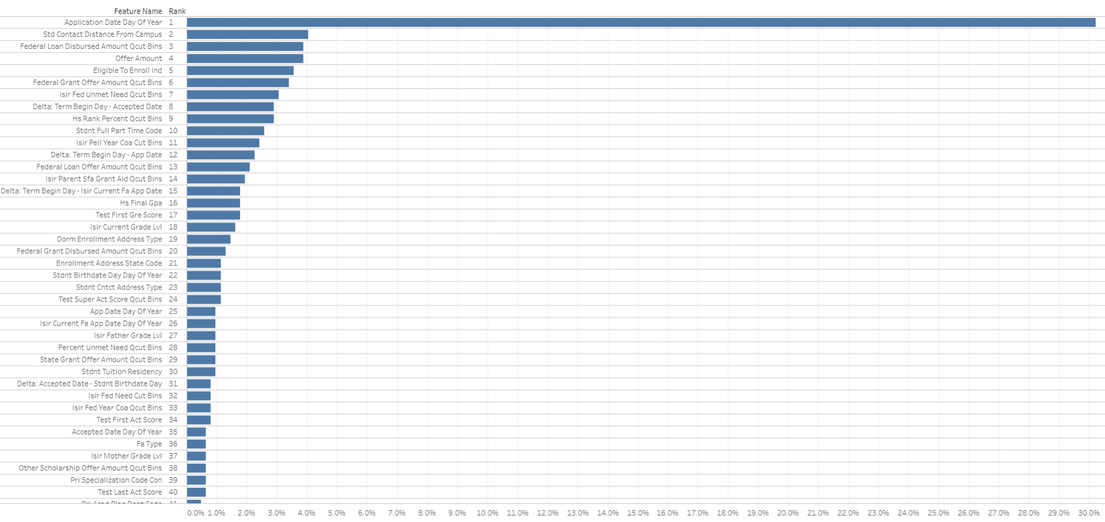
Data Science – Baccalaureate Freshman Retention Model
Business Information and Purpose
Incoming Freshman and continuing students are at risk of not retaining; negative impacts to the student and University
Two Models (currently)
Beginning of Fall semester
End of Fall semester (after grades recorded)
Key Findings
TOP: Interval application date and semester start
HS GPA, Distance from campus, and financial aid consistently near top of features list
Modeling contains nearly 80 variables
Others include HS rank, full/part time, Dorm/commuter, parent grade level, and many more
Feature List (intentionally small)

Slide 20
Data Science – Baccalaureate Freshman Retention Model
Next Steps
Have been running -- by hand -- weekly modeling sessions for BoFS as students register for fall 2021
Integrated data science scoring and results with ESP
Expand to model additional years (soph., jr., sr.)
Model additional degree pathways (1yr, 2yr, grad)
Begin adding behavioral indicators and running models daily or weekly

Slide 21
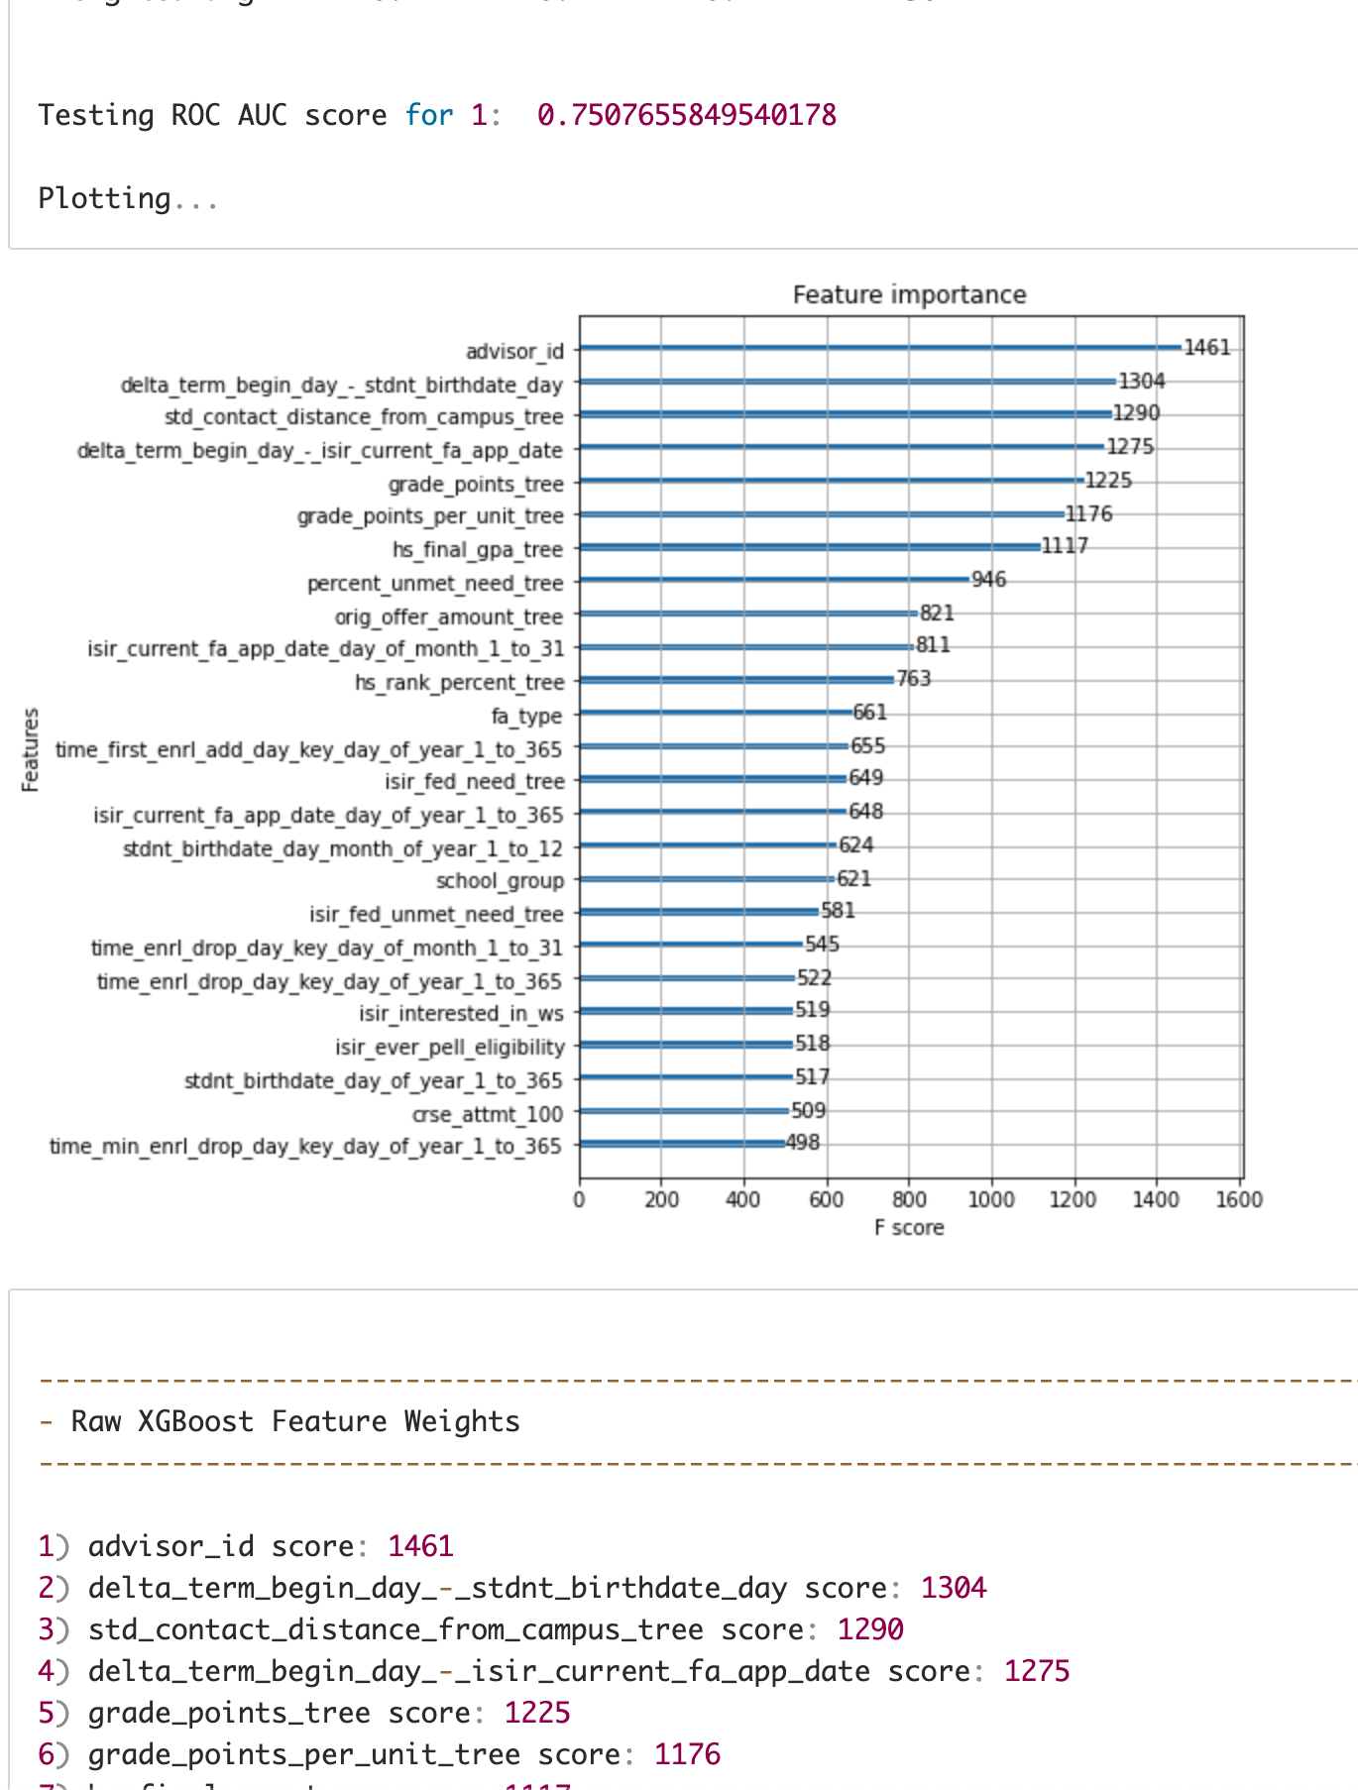
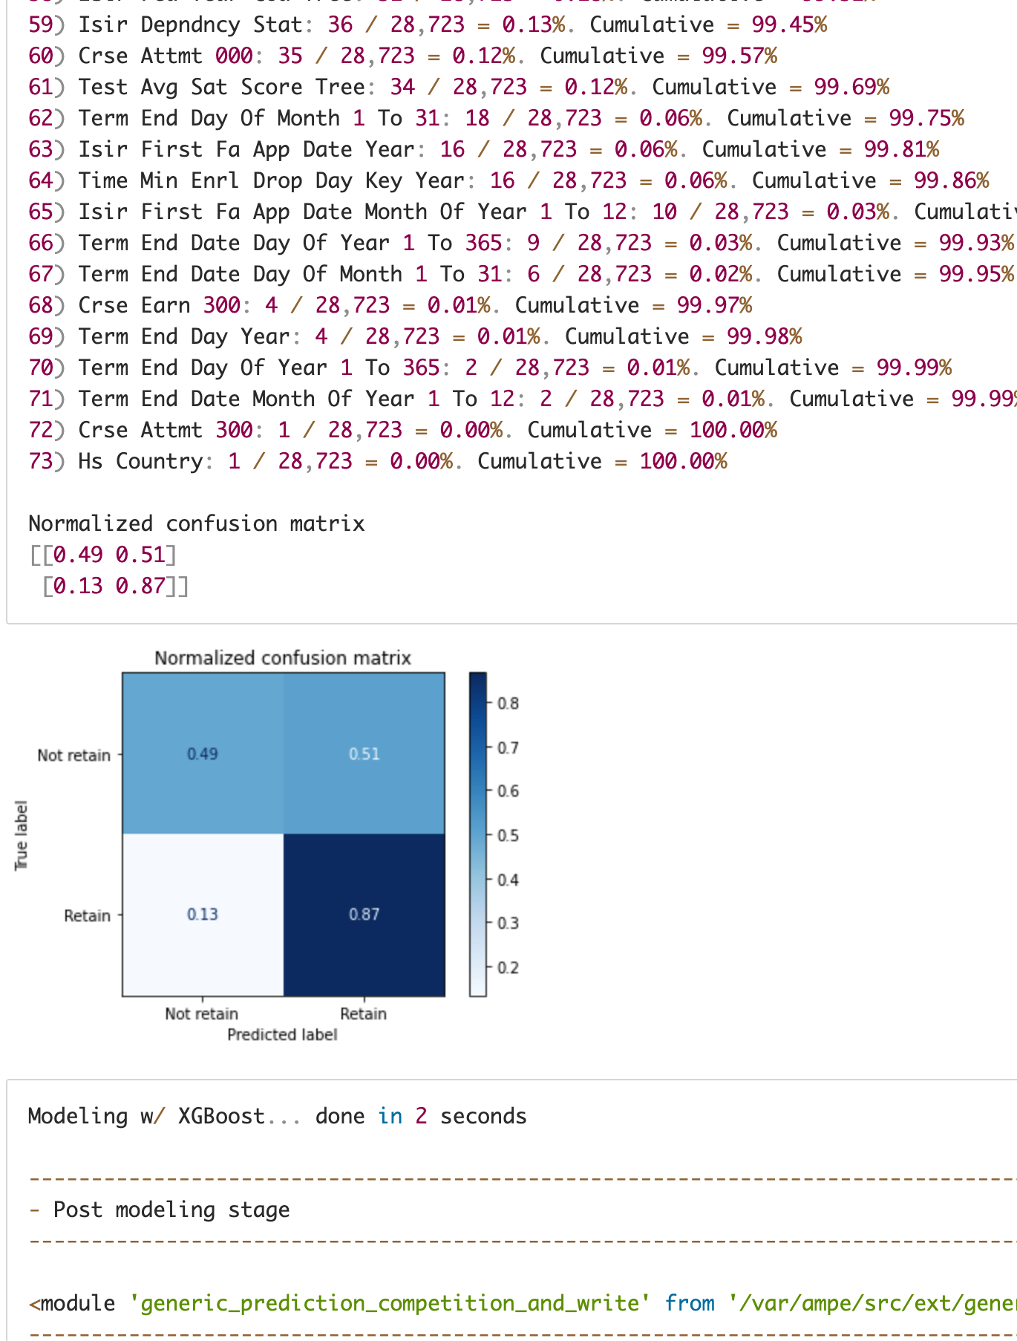
Data Science – Algorithms, Complexity, and Accuracy
Competitions: 5 modeling algorithms x 6 SMOTE over/under algorithms = 30 different models
Algorithms:(XGBoost, RandomForestClassifier, Sklearn.LogisticRegression, GradientBoostingClassifier, DecisionTreeClassifier, AdaBoostClassifier) x SMOTE over/under sampling: (None, ENN, TOMEK, ADASYN, RANDOM, SMOTE)
Server: Intel Xeon w/ 16 CPU cores and 128GB RAM, Multiple Trillions of Floating Point Ops/second
Accuracy:
Non-resampled data: 78% overall, w/ 23% TN and 94% TP
Over/under sampled data: 78% overall, w/ 54% TN and 85% TP
Summary: Better TN lowers your FP rate, and FPs are expensive!
Ranked predictions: From low to high
Pre-triaged interventions: Can be now be targeted and strategic
True Negative rate = TN
True Positive rate = TP

Slide 22
Data Science – Example Student 59% Retention Index
Distance from Campus
Federal Unmet Need
Grade Points Per Unit
Original Aid Offer
FA App Date
Federal Grant Offer
Student is experiencing significant financial aid troubles
Top 3 features lowering their probability of retention below the average probability of 66%
Federal unmet need
Original student aid offer
Federal grant offer
Top 3 features pushing their probability of retention up, towards the average probability of 66%
Distance from campus
Grade points per unit
Financial aid application date

Slide 23
Data Science – Analysis Priorities
Expanded predictive modeling (phases 2 and 3)
Scholarship analysis - HSGPA Cutoff
Major changes analysis
Student success interventions program evaluation
Opportunities to increase enrollment yield
Financial aid optimization
High-risk students and graduation/time-to-completion impacts
Course success/sequencing (toxic combinations)
Barriers to transfer students’ success

Slide 24
Questions & Discussion

